Slide 1
Promises in JavaScript

Slide 2
What is a promise
A tool for managing asynchronous operations
A placeholder for successful result or failure
// presentationCompleted is a promise
const promise = presentationCompleted(‘promises in javascript’)
presentationCompleted(‘promises in javascript)
.then(davidWillAskQuestions)
.catch(haventUnderstoodHimYet)

Slide 3
3 States
Pending
No outcome as asynchronous operation hasn’t completed yet
Resolved
Asynchronous operation completed, resulting in a value/data
Rejected
Asynchronous operation failed

Slide 4
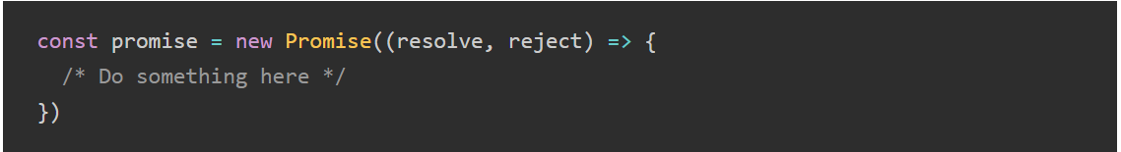
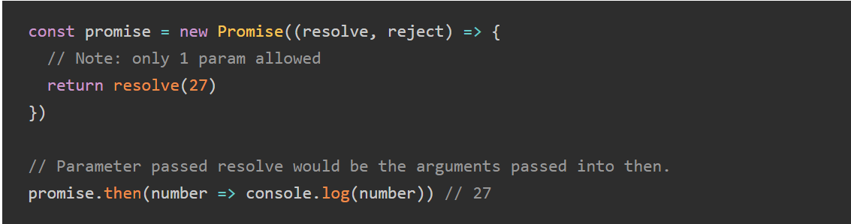
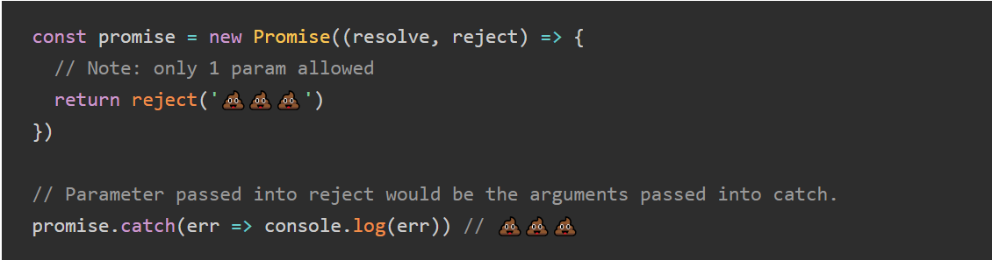
Constructing a Promise

Slide 5
Promises are promising because…
Code looks clean and more readable
Catching errors
Chaining

Slide 6

Simple Example
Charge a customer
01
Add customer to database
02
Send email to customer
03

Slide 7
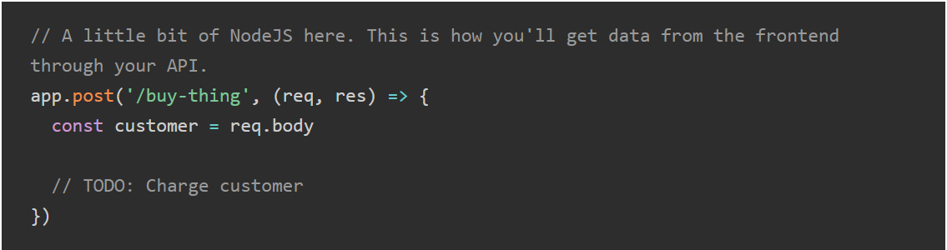
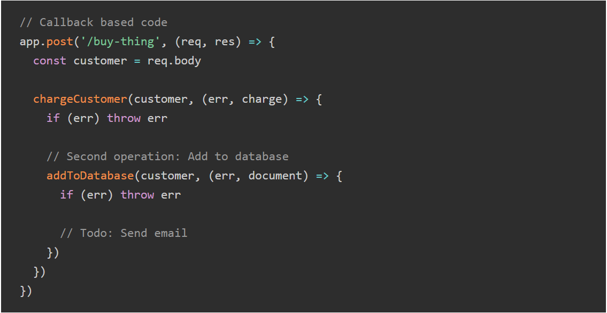
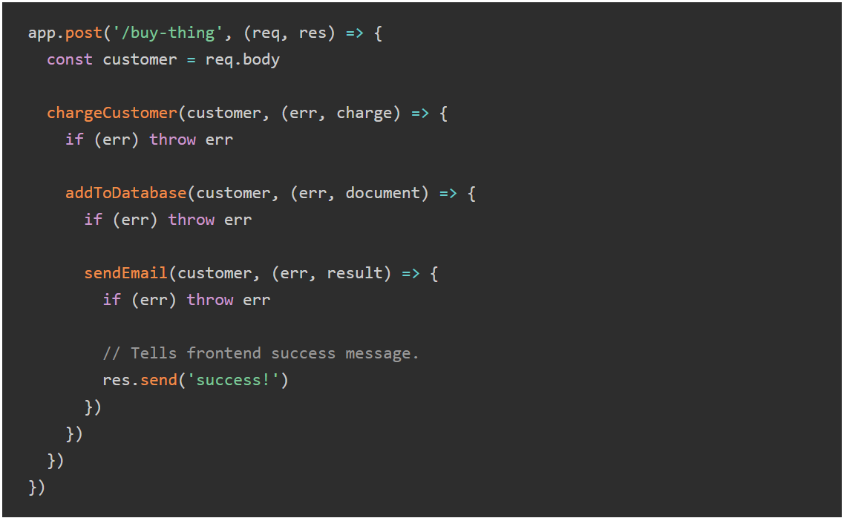
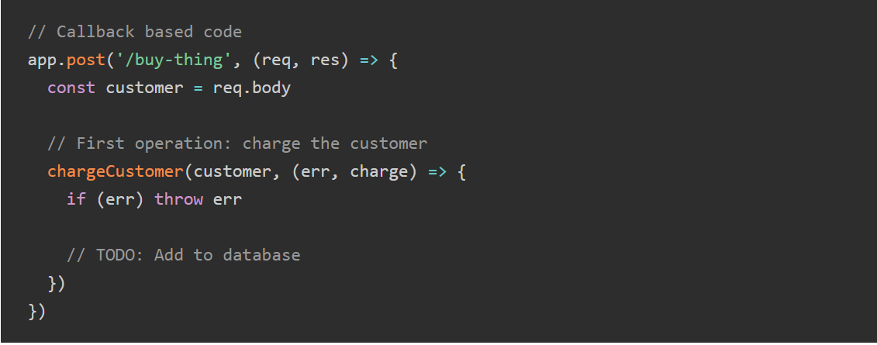
with callback

Slide 8
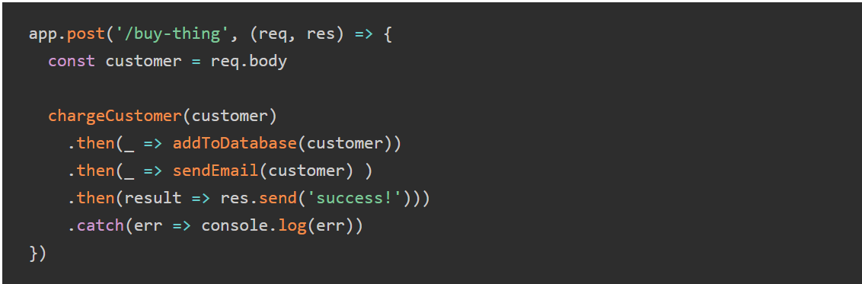
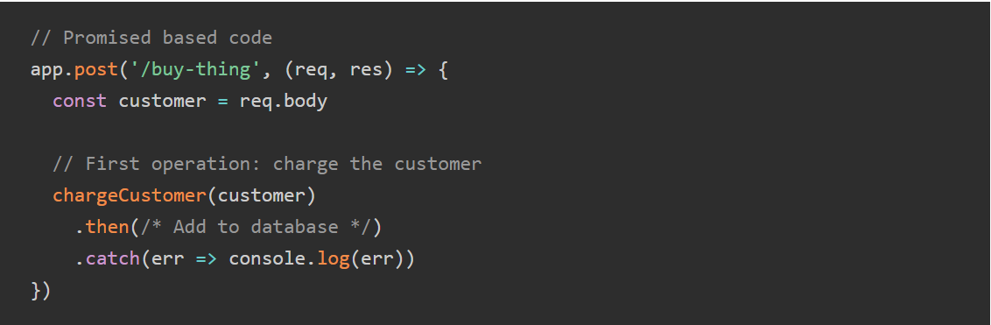
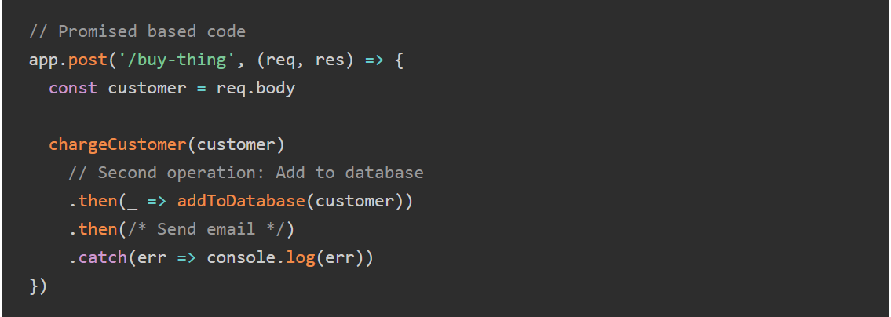
with Promise

Slide 9

Thank you!

